Slide 1
STOR 455 Logistic Regression and Inference
Read: 10.1 - 10.4
Exercises: 10.19, 23, 24

Slide 2
Thank you for the feedbacks!
“More exercises” “More extra credits”
Will have an extra credit homework.
“Someone in the group will do nothing”
The project is to mimic real working environment, in which you work with a team.
Communication and management are very important interpersonal skills for you in work. Don't wait until graduation. Practice them now.

Slide 3
Summary of Extra Credit Opportunities
Picking my math mistakes (not English typos or grammar mistakes) on slides and the blackboard. 0.5% each.
Finishing the course evaluation and forwarding me the confirmation. 1%.
Individual project on wrong linear models by April 29th. 1%.
Group project on movie box office prediction by April 19th.
Prediction competition: up to 1%.
Data collection and Analysis: 1%.
Extra credit homework: 2%. Details next week.

Slide 4
Binary Logistic Regression Model
Y = Binary response
X = Quantitative predictor
π = proportion of 1’s (yes, success,…) at any x
Probability form
Logit form
Linear Model

Slide 5
Categorical Predictors with Multiple Categories in Logistic Regression
Example: Predicting survival in an intensive care unit (ICU)
Response
Predictor
Data in the Stat2Data package - ICU.csv

Slide 6
Categorical Predictors with Multiple Categories in Logistic Regression
Two approaches:
Method #1: Logistic regression for Survive with AgeGroup as a quantitative predictor.
Method #2: Use dummy (indicator) variables for the age categories as predictors in a logistic regression model for Survive.

Slide 7
Method #1: AgeGroup as Quantitative Pred
> ICUmod = glm(Survive~AgeGroup, data=ICU, family=binomial)
> summary(ICUmod)
Coefficients:
Estimate Std. Error z value Pr(>|z|)
(Intercept) 2.7566 0.5732 4.809 1.52e-06 ***
AgeGroup -0.6399 0.2414 -2.651 0.00802 **
---
Signif. codes: 0 ‘***’ 0.001 ‘**’ 0.01 ‘*’ 0.05 ‘.’ 0.1 ‘ ’ 1
(Dispersion parameter for binomial family taken to be 1)
Null deviance: 200.16 on 199 degrees of freedom
Residual deviance: 192.66 on 198 degrees of freedom

Slide 8
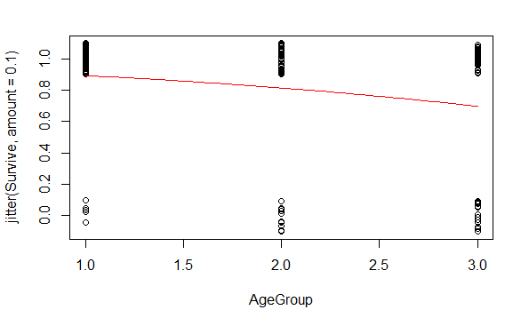
Method #1: AgeGroup as Quantitative Pred
> B0 = summary(ICUmod)$coef[1]
> B1 = summary(ICUmod)$coef[2]
> plot(jitter(Survive,amount=0.1)~AgeGroup,data=ICU)
> curve(logit(B0,B1,x),add=TRUE, col="red")

Slide 9
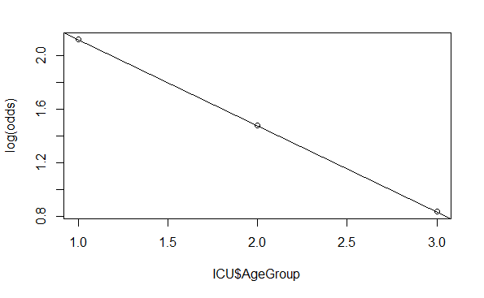
Method #1: AgeGroup as Quantitative Pred
> pi = logit(B0,B1,ICU$AgeGroup)
> odds = pi/(1-pi)
> plot(log(odds)~ICU$AgeGroup)
> abline(B0,B1)

Slide 10
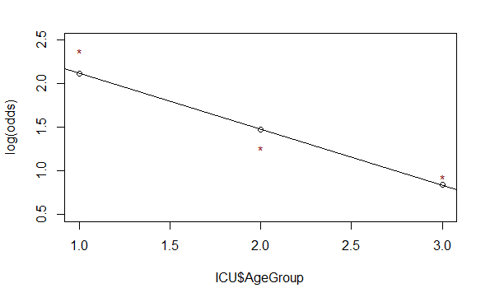
Two-way Table: Survive by AgeGroup
logodds.ICU.table = log(ICU.prop.table/(1-ICU.prop.table))
1 2 3
0 -2.3795461 -1.2611312 -0.9382696
1 2.3795461 1.2611312 0.9382696
logodds.ICU.df = t(as.data.frame.matrix(logodds.ICU.table))
plot(log(odds)~ICU$AgeGroup, ylim=c(.5, 2.5))
abline(B0,B1)
points(logodds.ICU.df[,2], col="dark red",pch="*")

Slide 11
Dummy Indicators for Multiple Categories
For a categorical predictor with k levels, we should use k − 1 dummy indicators.
...
What happens to Group #k?
Reference group
Constant term is an estimate for Group #k and other coefficients are the differences from it.

Slide 12
Binary Logistic Regression Model
Y = Binary response
X₁,X₂,…,X_{k} = Multiple predictors
X = Single predictor
π = proportion of 1’s (yes, success) at any x
π = proportion of 1’s at any x₁, x₂, …, x_{k}
Equivalent forms of the logistic regression model:
Logit form
Probability form

Slide 13
Method #2: Survive ~ Middle + Old
ICUmod.2 = glm(Survive~factor(AgeGroup), data=ICU, family=binomial)
summary(ICUmod.2)
Coefficients:
Estimate Std. Error z value Pr(>|z|)
(Intercept) 2.3795 0.4675 5.090 3.57e-07 ***
factor(AgeGroup)2 -1.1184 0.5422 -2.063 0.03915 *
factor(AgeGroup)3 -1.4413 0.5439 -2.650 0.00805 **
---
Signif. codes: 0 ‘***’ 0.001 ‘**’ 0.01 ‘*’ 0.05 ‘.’ 0.1 ‘ ’ 1
(Dispersion parameter for binomial family taken to be 1)
Null deviance: 200.16 on 199 degrees of freedom
Residual deviance: 191.59 on 197 degrees of freedom
AIC: 197.59

Slide 14
Interpreting Individual Tests
Similar issues to ordinary regression:
Is the predictor helpful, given the other predictors are already in the model?
Beware of problems due to multicollinearity.
Try to keep the model simple.

Slide 15

G-Test for Overall Fit
(Similar to regression ANOVA455)
H₀:β₁=β₂=…=β_{k}=0 vs. H_{a}: Some β_{i} ≠ 0
t.s. = G = improvement in –2log(L) over a model with just a constant term
Compare to χ² with k d.f.
# predictors
Null deviance: 200.16 on 199 degrees of freedom
Residual deviance: 191.59 on 197 degrees of freedom
$$G=200.16−191.59=8.57$$
1-pchisq(8.57,2)
[1] 0.01377362
Reject H₀

Slide 16
Method #2: Survive ~ Middle + Old
ICUmod.2 = glm(Survive~factor(AgeGroup), data=ICU, family=binomial)
summary(ICUmod.2)
log(odds) for Young
Coefficients:
Estimate Std. Error z value Pr(>|z|)
(Intercept) 2.3795 0.4675 5.090 3.57e-07 ***
factor(AgeGroup)2 -1.1184 0.5422 -2.063 0.03915 *
factor(AgeGroup)3 -1.4413 0.5439 -2.650 0.00805 **
Change in log(odds) for Middle and Old—compared to Young
1-pchisq(ICUmod.2$null.deviance - ICUmod.2$deviance, ICUmod.2$df.null - ICUmod.2$df.residual)
[1] 0.01375896

Slide 17
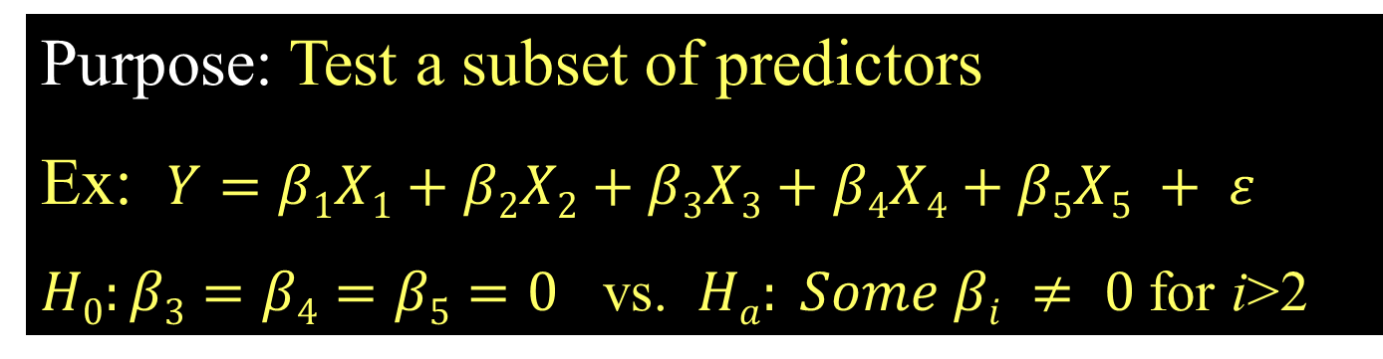
Recall: Nested F-test
Purpose: Test a subset of predictors
Ex: $Y=β1X1+β2X2+β3X3+β4X4+β5X5 + ε$
$H0:β3=β4=β5=0$ vs. $Ha: Some βi ≠ 0$for i>2
Basic idea: Is the improvement (reduction in SSE) “significant” for the number of extra predictors?
i.e. Compare “full” model to “reduced” model
t.s.= F-ratio (interpret similar to ANOVA)

Slide 18
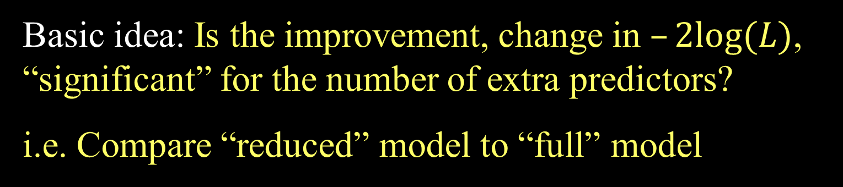
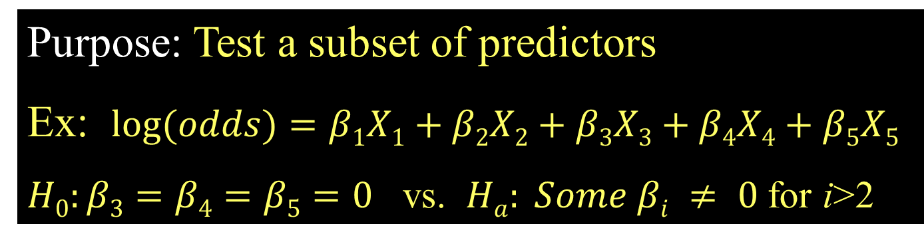
Nested LRT for Logistic Regression (Likelihood Ratio Test)
Purpose: Test a subset of predictors
Ex: $log⁡(odds)=β1X1+β2X2+β3X3+β4X4+β5X5$
$H0:β3=β4=β5=0$ vs. $Ha: Some βi ≠ 0$for i>2
Basic idea: Is the improvement, change in $–2log⁡(L)$, “significant” for the number of extra predictors?
i.e. Compare “reduced” model to “full” model
$χ^{2}=–2log⁡(LReduced) – (–2log⁡(LFull))$
Chi-square d.f.=#extra predictors tested

Slide 19
Comparing Full to Reduced Models
ICUmod.4 = glm(Survive~factor(AgeGroup)+Emergency, data=ICU, family=binomial)
Null deviance: 200.16 on 199 degrees of freedom
Residual deviance: 171.16 on 196 degrees of freedom
FULL
ICUmod.2 = glm(Survive~factor(AgeGroup), data=ICU, family=binomial)
Null deviance: 200.16 on 199 degrees of freedom
Residual deviance: 191.59 on 197 degrees of freedom
Reduced
$H0:β3=0$ vs. $Ha: β3 ≠ 0$
1 - pchisq(summary(ICUmod.2)$deviance - summary(ICUmod.4)$deviance, 1)
Reject H₀ (p-value= 6.187652e-06). The Emergency term significantly improves the model.
This is also often called a “Drop-in-Deviance” test.

Slide 20
Example: Predicting Medical School Acceptance
Data: MedGPA
Accept Status: A=accepted to medical school or D=denied admission
Acceptance Indicator for Accept: 1=accepted or 0=denied
Sex F=female or M=male
BCPM Bio/Chem/Physics/Math grade point average
GPA College grade point average
VR Verbal reasoning (subscore)
PS Physical sciences (subscore)
WS Writing sample (subcore)
BS Biological sciences (subscore)
MCAT Score on the MCAT exam (sum of CR+PS+WS+BS)
Apps Number of medical schools applied to
Find the “best” model for Acceptance using some or all of these predictors.

Slide 21
bestglm for Model Selection
Requirements to use bestglm()
Only the response and possible predictor variables should be within the dataframe
MedGPA.1 = within(MedGPA, {Accept = NULL})
The response variable must be the last column in the dataframe.
MedGPA.2 = MedGPA.1[,c(2:10,1)]

Slide 22
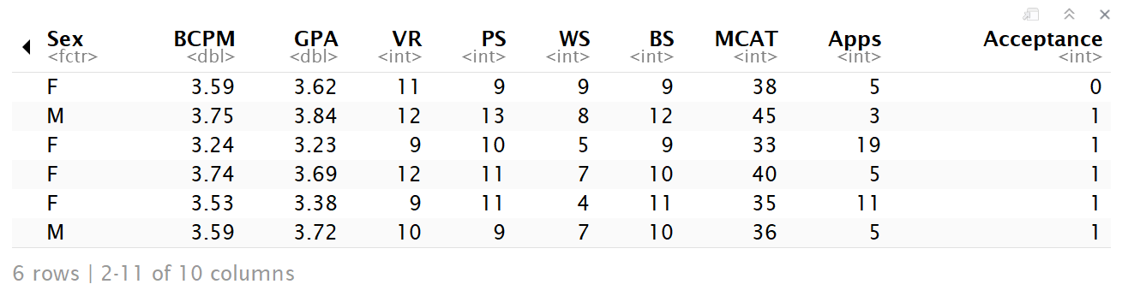
bestglm for Model Selection
head(MedGPA.2)

Slide 23
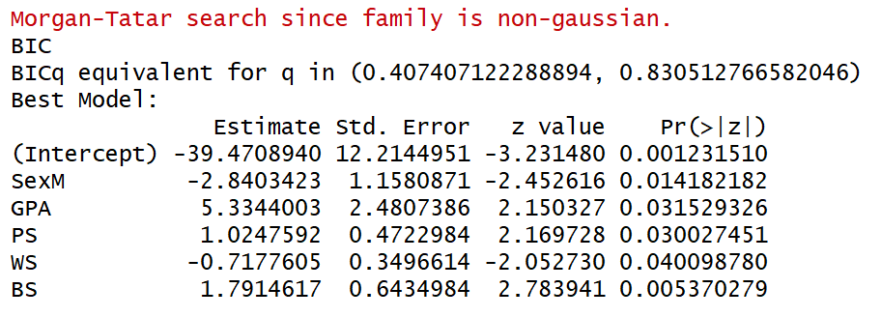
bestglm for Model Selection
bestglm(MedGPA.2, family=binomial)
Bayesian Information Criteria

Slide 24
Bayesian Information Criteria
n : sample size
k : number of predictors
θ : set of all parameters.
L(θ̂) :probability of obtaining the data which you have, supposing the model being tested was a given.
k log(n)- 2log(L(θ̂))
Selection criteria, similar to Mallow’s Cp
Smaller values indicate preferred models

Slide 25
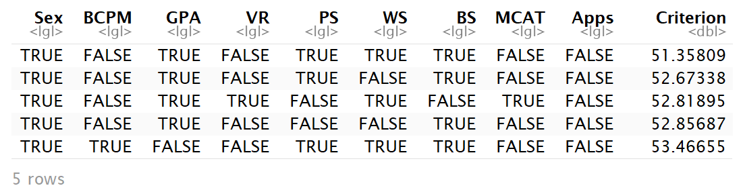
Comparing Models by BIC
ΔBIC | Evidence against higher BIC
0 to 2 | Little
2 to 6 | Positive
6 to 10 | Strong
>10 | Very strong
MedGPA.2.bestglm = bestglm(MedGPA.2, family=binomial)
MedGPA.2.bestglm$BestModels

Slide 26
Example: Predicting Survival
Data: ICU
ID Patient ID code
Survive 1=patient survived to discharge or 0=patient died
Age Age (in years)
AgeGroup 1= young (under 50), 2= middle (50-69), 3 = old (70+)
Sex 1=female or 0=male
Infection 1=infection suspected or 0=no infection
SysBP Systolic blood pressure (in mm of Hg)
Pulse Heart rate (beats per minute)
Emergency 1=emergency admission or 0=elective admission
Find the “best” model for Survival using some or all of these predictors.

Slide 27
bestglm for Model Selection
Requirements to use bestglm()
Only the response and possible predictor variables should be within the dataframe
ICU.1 = within(ICU, {ID = NULL})
The response variable must be the last column in the dataframe.
ICU.1 = ICU.1[,c(2:8,1)]

Slide 28
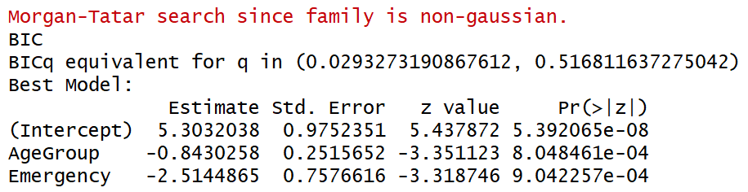
bestglm for Model Selection
bestglm(ICU.1, family=binomial)
Treated as quantitative

Slide 29
bestglm for Model Selection
Requirements to use bestglm()
Create dummy variables for non binary categorical variables.
ICU.2$AgeGroup2 = ifelse(ICU.2$AgeGroup==2,1,0)
ICU.2$AgeGroup3 = ifelse(ICU.2$AgeGroup==3,1,0)
#delete AgeGroup variable
ICU.3 <- within(ICU.2, {AgeGroup = NULL})
#reorder columns with response last
ICU.4 = ICU.3[,c(1:6,8,9,7)]

Slide 30
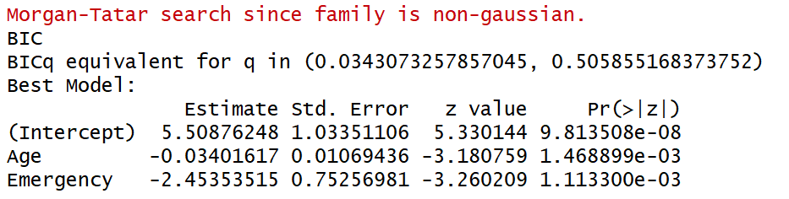
bestglm for Model Selection
bestglm(ICU.4, family=binomial)

Slide 31
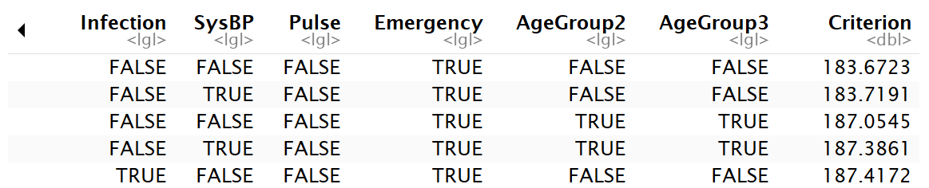
Comparing Models by BIC
ΔBIC | Evidence against higher BIC
0 to 2 | Little
2 to 6 | Positive
6 to 10 | Strong
>10 | Very strong
ICU.4.bestglm = bestglm(ICU.4, family=binomial)
ICU.4.bestglm$BestModels

